Slide 1
CS 160 Project - Entropy Analysis
Frank, Henry, John, Dennis, Ben

Slide 2
Customer’s Request
“… You will need to realize some sort of application that analyzes the incoming traffic from the router to the client computer. We want this application to run on Windows, and if possible even Mac. A useful UI is requested. Do not hesitate to ask for more information, we would be glad to collaborate as much as we can…”
Which algorithm to use to analyze router traffic?

Slide 3

Shannon’s Entropy
Shannon Entropy of X in entropy / character
N = total number of characters
count_i = the count of character count_i

Slide 4

Language
We chose to use Python as the language for this program

Slide 5
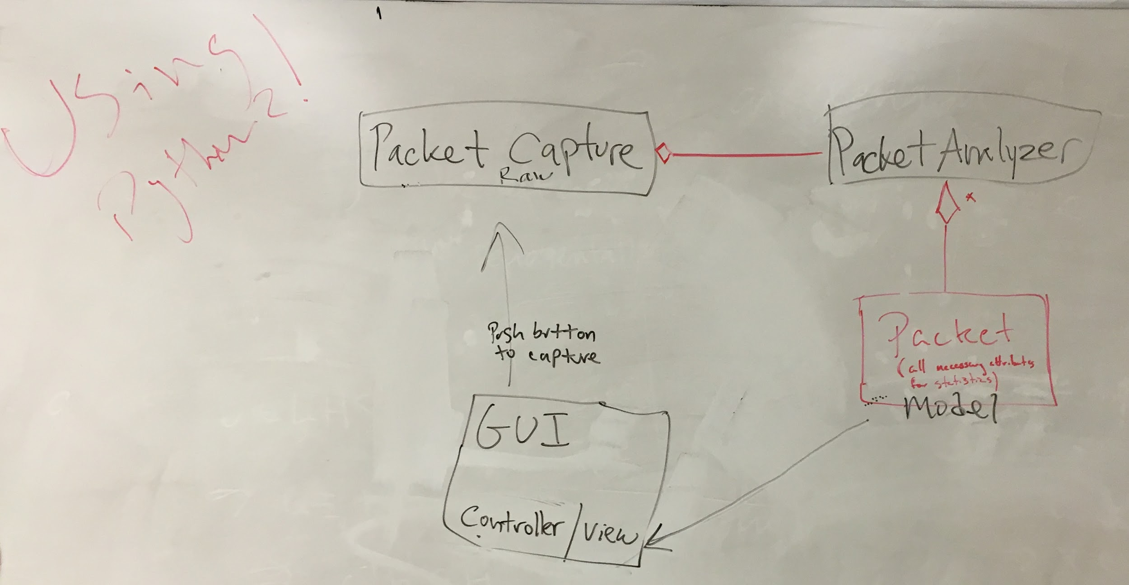
Our Initial Plan

Slide 6
Challenges
Network Programming
Threaded Programming
Calculate Entropy Result

Slide 7

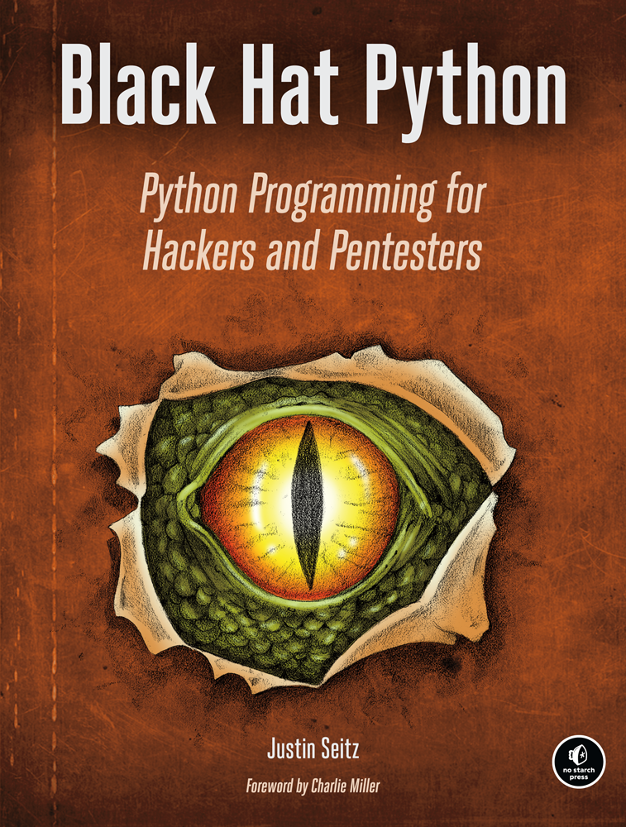

What to use to capture packets?
We decided to use just regular Python since no add-on module was necessary
Left two books helped us figure out how do Python socket programming
Book on far right helped us understand structure of network frames/packets

Slide 8
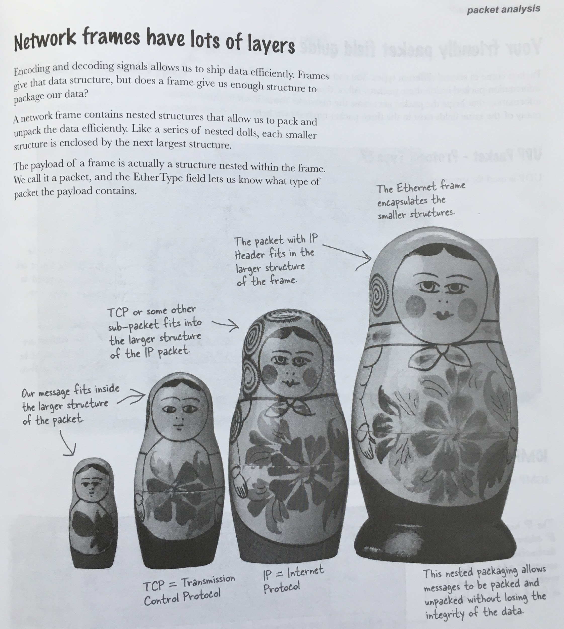
Network Frame Layers
Our target data was buried under many layers
Image from Head First Networking book

Slide 9
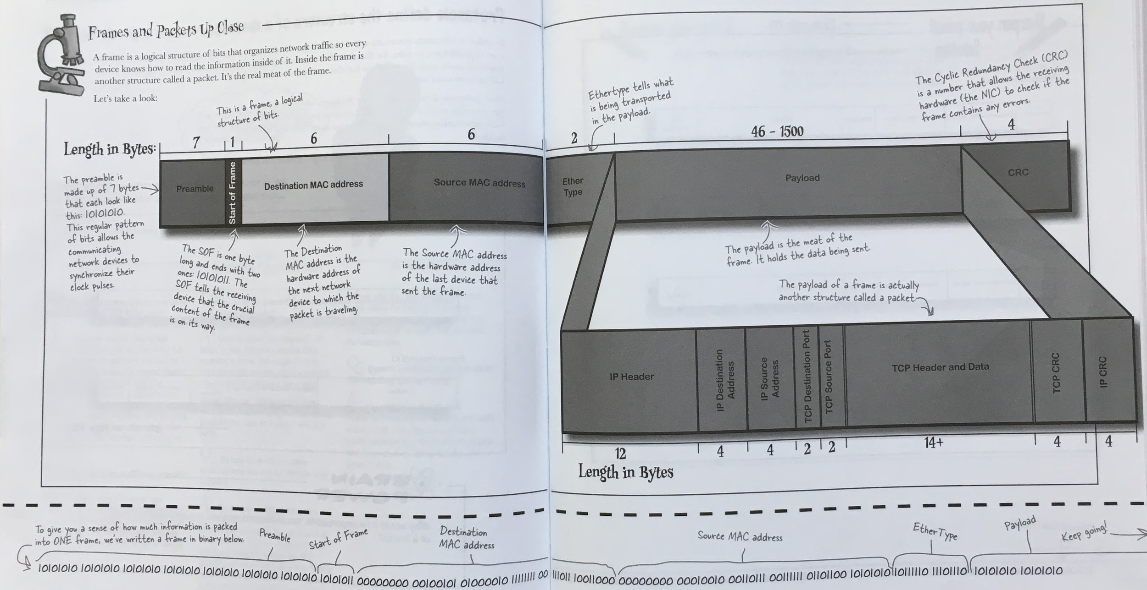
The Structure of a Frame
Image from Head First Networking book

Slide 10
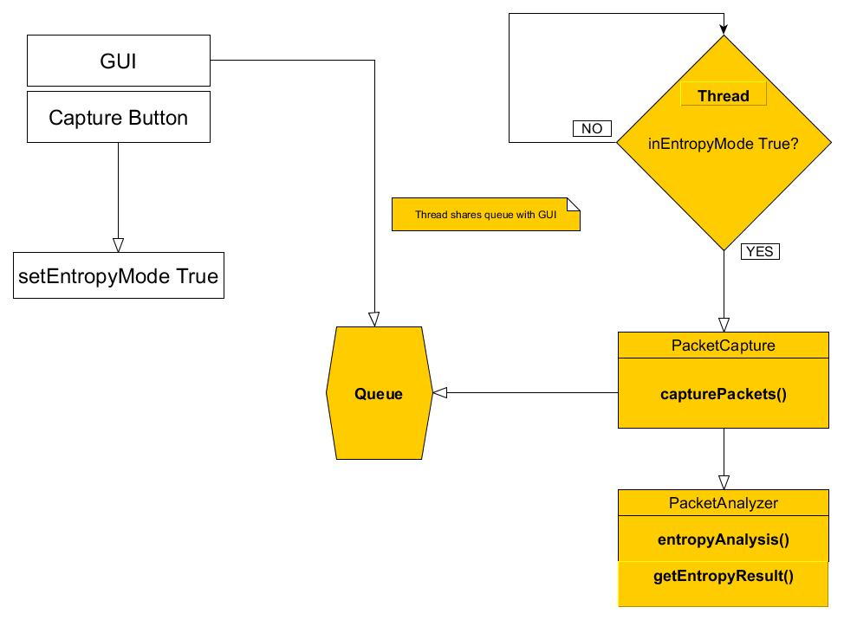
Work is done in separate thread from GUI

Slide 11
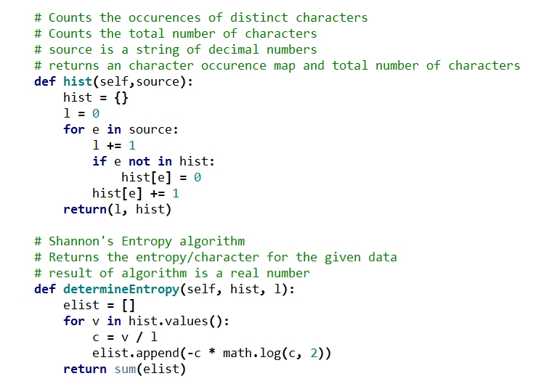
Shannon’s Entropy Algorithm

Slide 12
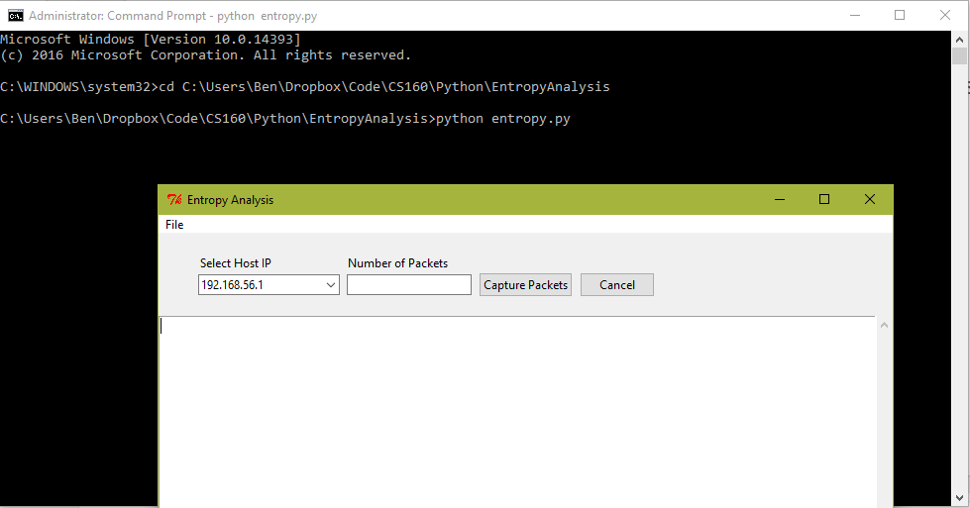
How to Run
To run the program (on Windows), you must launch the program with administrator privileges due to the program needing network access to read packets
The .py file to run is
entropy.py

Slide 13
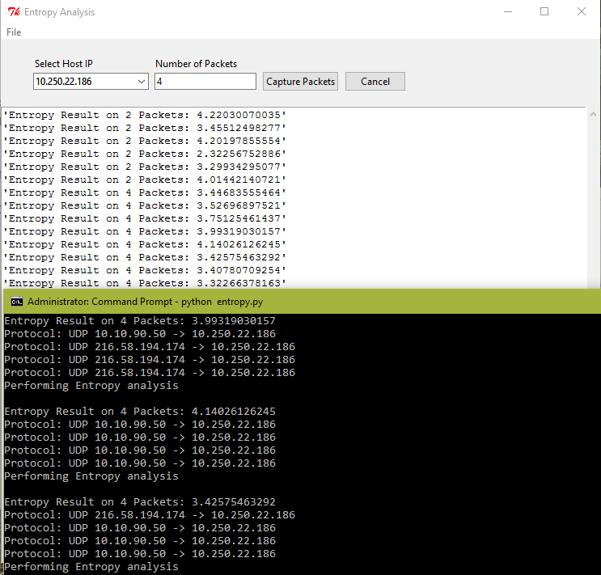
How to Use (1/2)
After starting the program, you need to specify a host IP from the dropdown to read packets from and how many packets to read per entropy analysis performed
You can modify how many packets to read per analysis as the program runs
The console will also be displaying some more detailed information on incoming packets as they are found

Slide 14
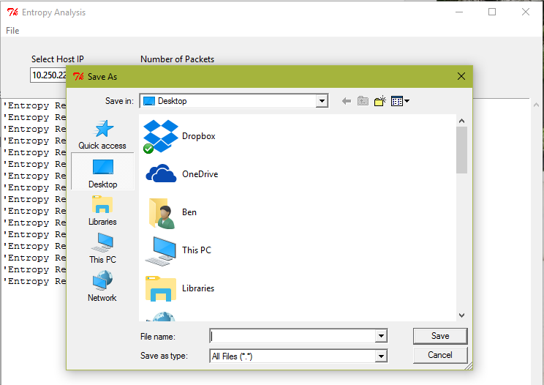
How to Use (2/2)
You can save the results as a normal text file by going to File > Save
You can reload the results into the program by going to File > Open

